Slide 1
Introduction to Microprocessor

Slide 2
Books
Microprocessor Architecture, Programming, and Applications with 8085 by Ramesh Gaonkar, 6ed.
Advanced Microprocessors and Peripherals by KM Bhurchandi and AK Ray
Microprocessor and Interfacing by DV Hall, TMH,2ed.

Slide 3
Introduction
Microcomputer:
A microcomputer is a computer that uses a microprocessor as its CPU. The system formed by interfacing the microprocessor with memory and I/O devices to execute required program
The Microprocessor is the brain of the microcomputer

Slide 4
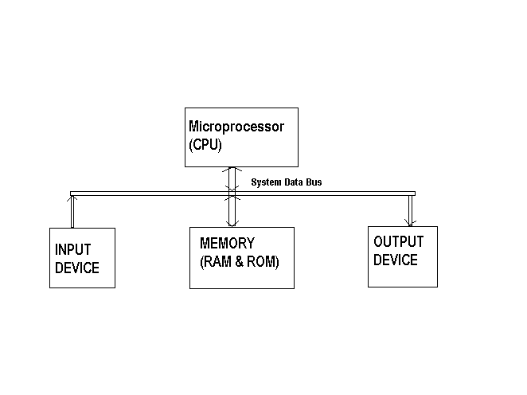
Block diagram of microcomputer

Slide 5
Introduction
Microprocessor:
A microprocessor is a multipurpose, programmable, clock driven, register and ALU based electronic device.
The key element of all computers, providing the mathematical and decision making ability.
It reads binary instructions from a storage device, called memory. Accepts binary data as input, process them as per instruction and provides result as output.

Slide 6
Organization of a microprocessor based system:
ALU
Register Section
Address bus
Data bus
Control and timing section
Control bus

Slide 7
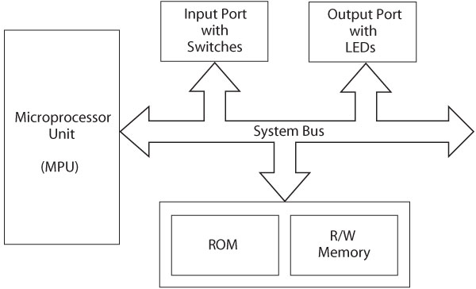
Microprocessor-based system

Slide 8
Bus: A bus is a group of wires/lines that carry similar information.
System Bus: The system bus is a group of wires/lines used for communication between the microprocessor and peripherals.
Memory Word: The number of bits that can be stored in a register or memory element is called a memory word.

Slide 9
Address Bus:
It carries the address, which is a unique binary pattern used to identify a memory location or an I/O port.
For example, an eight bit address bus has eight lines and thus it can address 256 different locations (00H – FFH).

Slide 10
Data Bus:
The data bus is used to transfer data between memory and processor or between I/O device and processor.
Control Bus:
The control bus carry control signals
Consists of signals for
selection of memory or I/O device from the given address
direction of data transfer
synchronization of data transfer in case of slow devices.

Slide 11
Arithmetic & Logic Unit (ALU)
It performs mathematical calculations (subtract, multiply, divide, etc), comparisons (is greater than, is smaller than, etc.) and logical operations (NOT, OR, AND, etc)
Register set
Store intermediate and final results from their calculations in ALU.
Registers are normally measured by the number of bits they can hold, for example, an 8-bit register or a 32-bit register

Slide 12
Characteristics of a Microprocessor
Three basic characteristics differentiate microprocessors:
Instruction set: The set of instructions that the microprocessor can execute.
Bandwidth: The number of bits processed in a single instruction.
Clock speed: Given in megahertz (MHz), the clock speed determines how many instructions per second the processor can execute.

Slide 13
Classification of Microprocessors
Based on their specification, application and architecture microprocessors are classified.
Based on size of data bus:
4-bit/8bit/16bit/32bit microprocessor
Based on application:
General-purpose microprocessor
8085 to Intel Pentium
Special-purpose processors
designed to handle special functions required for an application
Microcontroller
microprocessor with built-in memory and ports and can be programmed for any generic control application. Example, 8051

Slide 14
Microcontroller
Integrated electronic computing device that includes three major components on a single chip
Microprocessor (MPU)
Memory
I/O (Input/Output) ports
-Also called as a single chip microcomputer

Slide 15
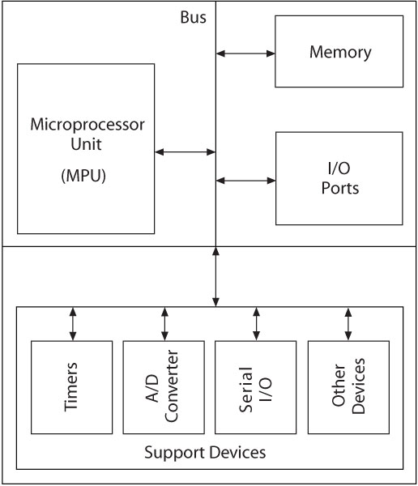
Block diagram of Microcontroller

Slide 16
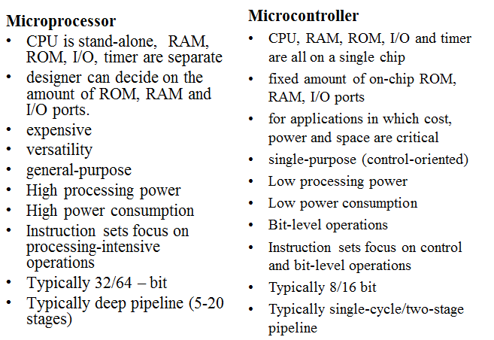
Microprocessor Vs. Microcontroller

Slide 17
History of microprocessor
Intel's 4004 is considered the first microprocessor
The 4004 was later followed in 1972 by the 8008, the world's first 8-bit microprocessor
Then is the 8080 microprocessor evolved in 1974. This microprocessor was used on the world's firs personal computer, named Altair
Then comes 8085 that is the 8 bit microprocessor

Slide 18
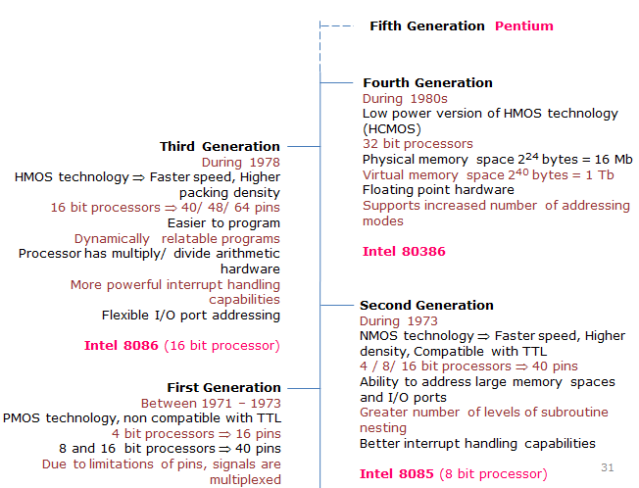

Slide 19
Store-program concept
Programs or instructions are sequentially stored in the memory locations that are to be executed.
To do any task using a microprocessor, it is to be programmed by the user.
The programmer must have idea about its internal resources, features and supported instructions.

